Slide 1
Movies Project
By Connie Nguyen, Joshua Nezianya, Lap Wu, Katherine Cheng

Slide 2
Project Explanation
Our project worked with different datasets from APIs and files and processed the data for specific information to display to the user.

Slide 3
Connie Nguyen
(Question)
Question: What are the top ten movies with the longest runtime?
Process: Using python tools like pandas and matplot I was able to extract the information I needed and display it.
https://www.kaggle.com/datasets/PromptCloudHQ/imdb-data
Lesson Learned: With this group project I learned more about the different python tools and how to extract information

Slide 4
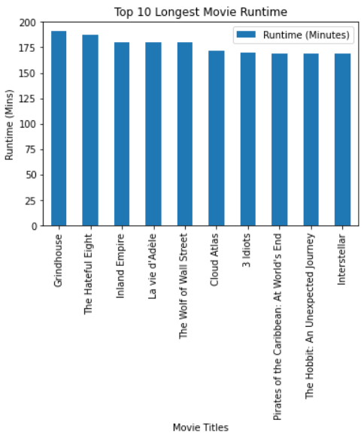
Connie Nguyen
(Answer)

Slide 5
Joshua Nezianya
(Questions)
What are the stats for your favorite movie?
What are the top 200 highest grossing films?
What year had the highest ranked movies?
What years had the highest grossing films?
API: https://imdb-api.com/

Slide 6
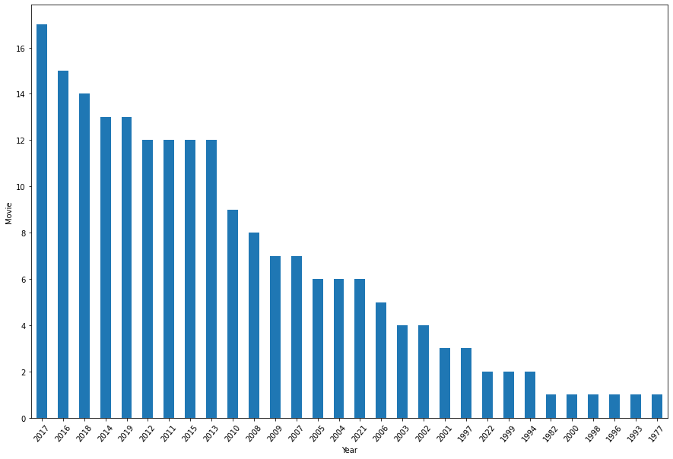
Joshua Nezianya
(Answer)
Years with the highest ranked movies

Slide 7
Lap Wu
(Question)
Question: What are the most common genres in the top-rated movie list?
To answer this question, I used the data from the movie database API and extracted the genre data of the movies in the top-rated section.
Working on this project helped me learn how to use API to requests data and how to read and manipulate these data.

Slide 8
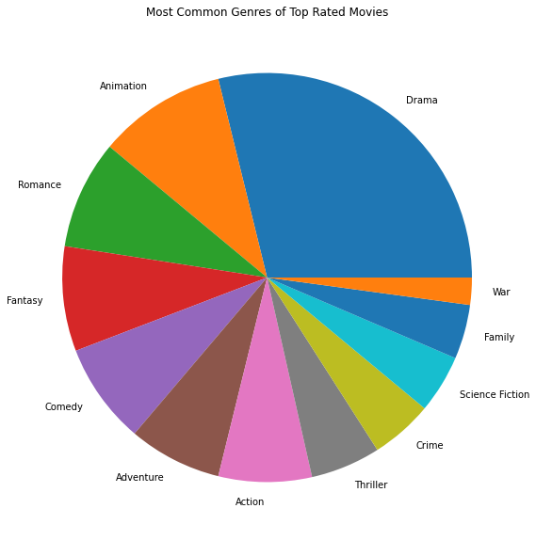
Lap Wu
(Answer)
These are the most common genres in the 160 movies that are the best rated.

